Slide 1
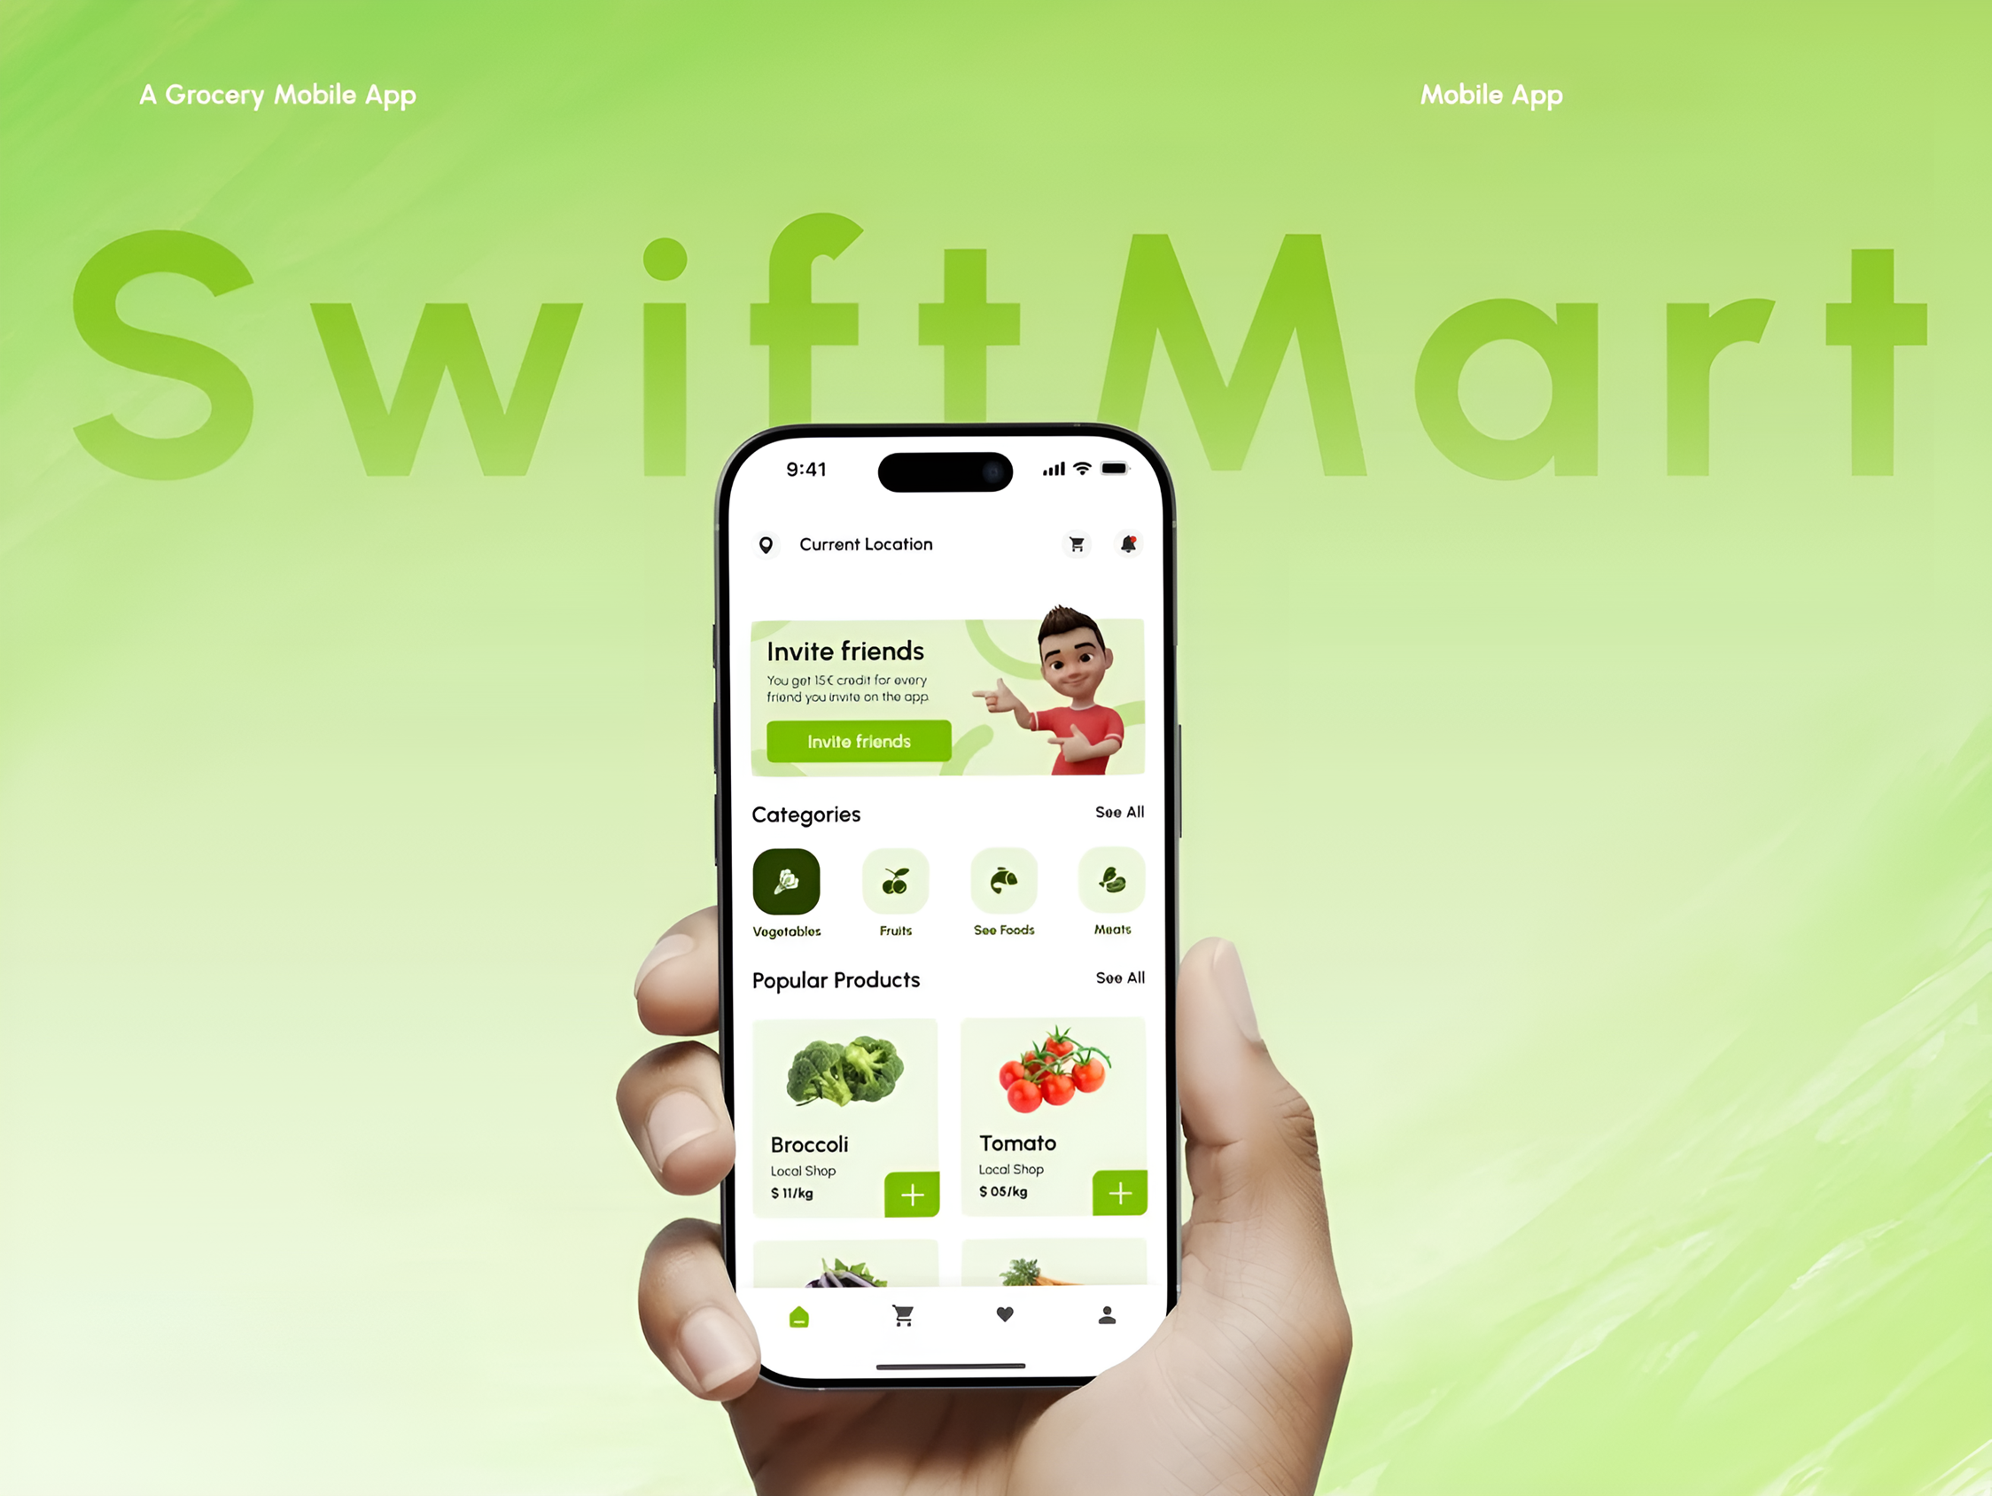
4Cs Analysis
"Swift Mart" Mobile App
Analyst: Jitendra Manasingh
@Analytical Framework

Slide 2

Swift Mart - Instant Delivery
The Company: "Swift Mart" is a mobile app offering 20-minute grocery delivery in residential areas of Ghaziabad, like Indirapuram and Vaishali.
The Situation: After a strong start, user growth has stopped. The company needs to figure out why from a customer's point of view.
Key Facts:
Target Users: Busy professionals and families who need items urgently.
Product: The selection is very limited compared to a supermarket. Customers are asking for more variety and healthier options.
Pricing: Items cost 10-15% more than local stores, and there's a delivery fee on small orders.
Convenience: The 20-minute delivery is a major plus, but the app sometimes cancels out-of-stock items automatically, and the service area is limited.
Marketing: Communication is one-way, consisting of aggressive online ads about speed and promotional push notifications. Customer service chat is slow, and questions on social media are ignored.

Slide 3
What is the 4Cs Analysis?
The 4Cs Analysis is a marketing and business strategy framework that prioritizes the Customer by focusing on their Wants and Needs, the Cost to Satisfy them, the Convenience to Buy, and Communication with them. This customer-centric approach aims to build stronger customer relationships and drive business success by ensuring products and services are tailored to meet customer demands, rather than simply pushing products.
As a Data Analyst, I need to analyze Swift Mart using the 4Cs framework. For each C—Consumer, Cost, Convenience, and Communication
I will identify key problem the company is currently facing.

Slide 4
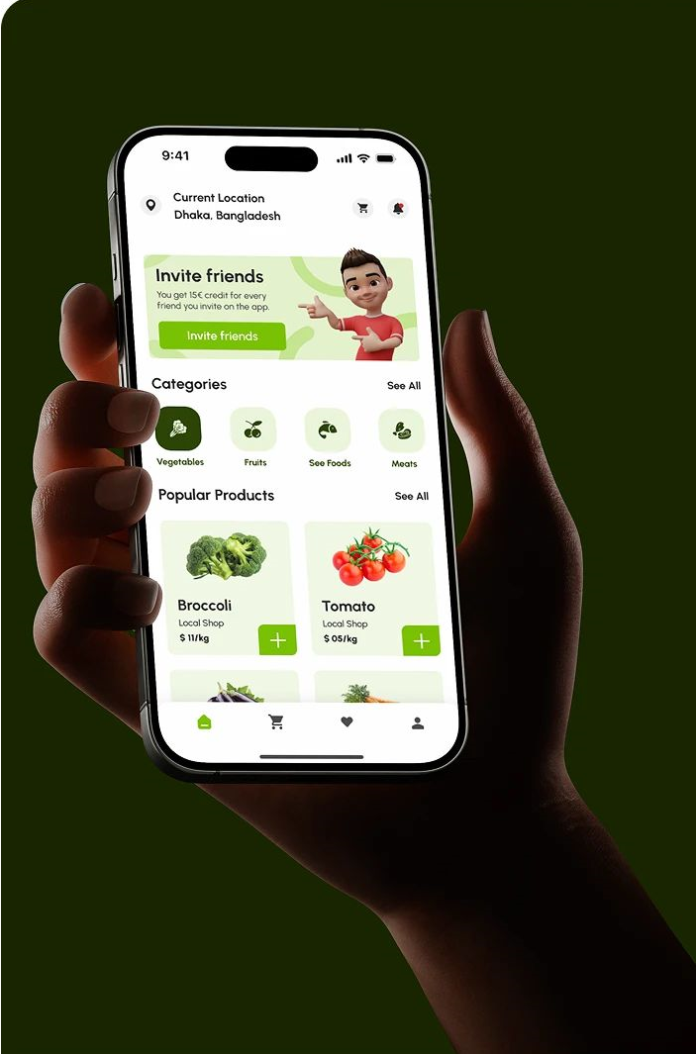
4Cs Analysis for Swift Mart
CONSUMER
(Needs & Preferences)
COST
(Price & Value)
CONVENIENCE
(Ease of Use & Access)
COMMUNICATION
(Engagement)
Limited product selection (~500 SKUs vs. ~3,000 in supermarkets)
Healthy options <5% of catalog
35% complaints about variety, 20% about health options
10–15% higher than local stores + ₹30 small-order fee
25% abandoned carts due to price
10% drop in repeat customer's last quarter
20-min delivery strong point, but 12% order cancellations
Service covers only 60% of Ghaziabad zones
15% app uninstalls due to stock or coverage issues
80% ad budget focused on speed
Customer support response: 15 mins avg.
Social response rate <20%
Sentiment score ↓ 18% (App rating 3.8/5 from 4.2/5)
IMPROVEMENT PLAN
IMPROVEMENT PLAN
IMPROVEMENT PLAN
IMPROVEMENT PLAN
Expand catalog by 50% within 6 months focusing on healthy & high-demand items.
Introduce loyalty program & free delivery for orders >₹250, negotiate supplier pricing to reduce cost by 5%
Implement live stock updates to reduce cancellations by 50% and expand coverage to 80% within 3 months.
Improve support response time to <5 mins, hire dedicated social media team, and run two-way engagement campaigns to boost sentiment by 20%.

Slide 5
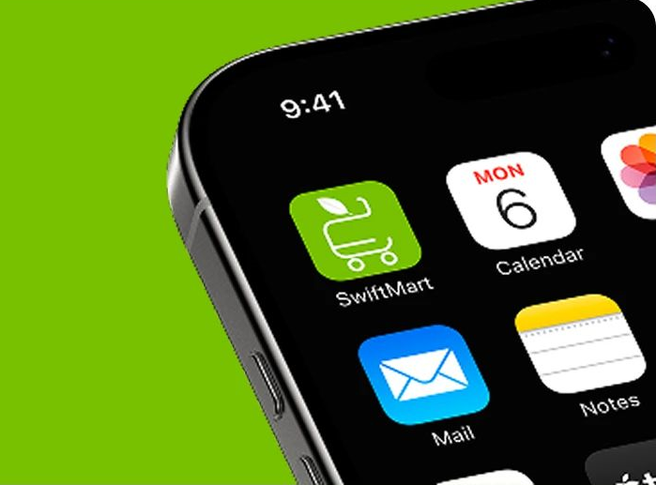
Thank
You!

